Slide 1
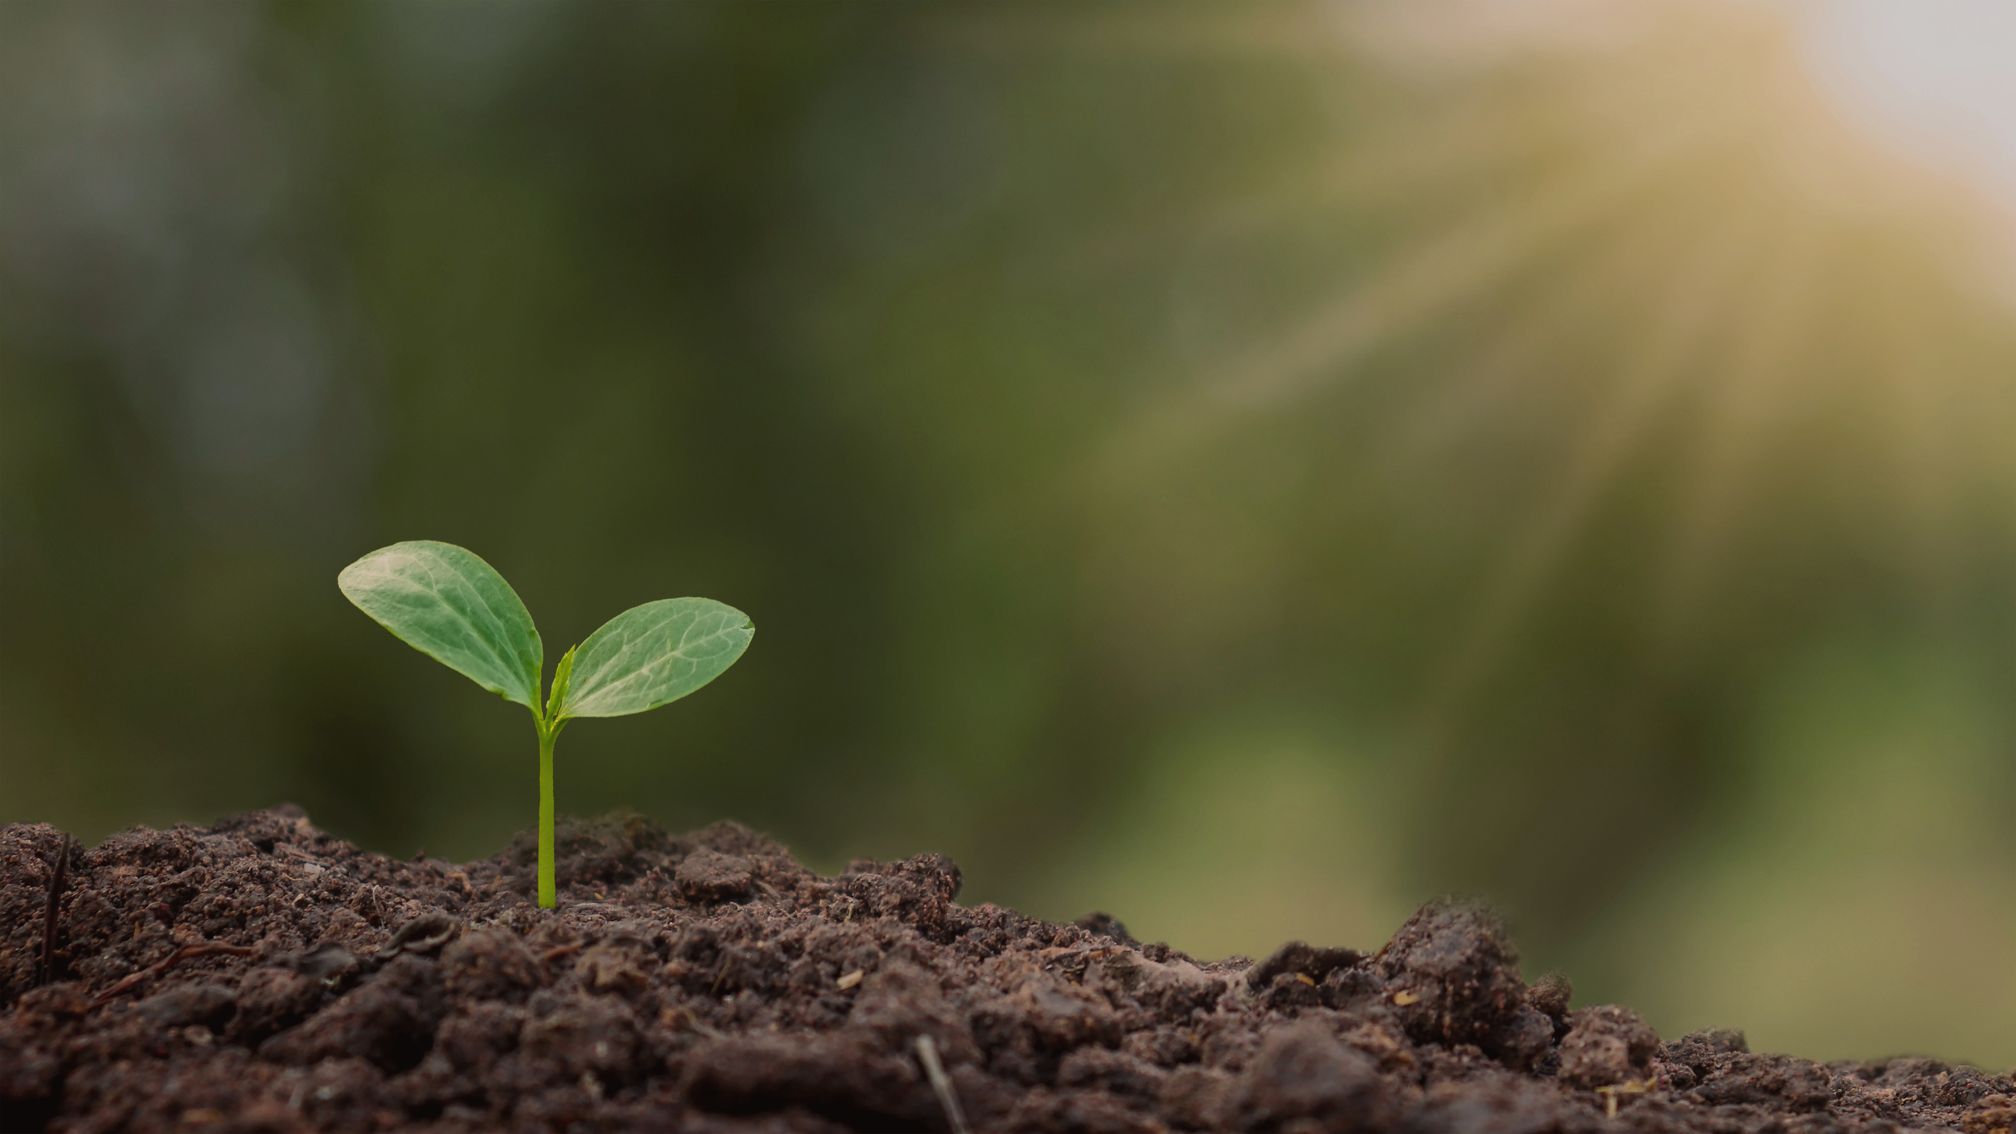

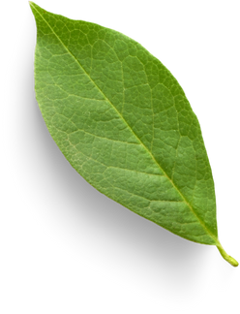
Ginyard International Co.
Home
Service
About Us
Contact
Plant Leaf Disease
Classification
Using
CNN

Slide 2
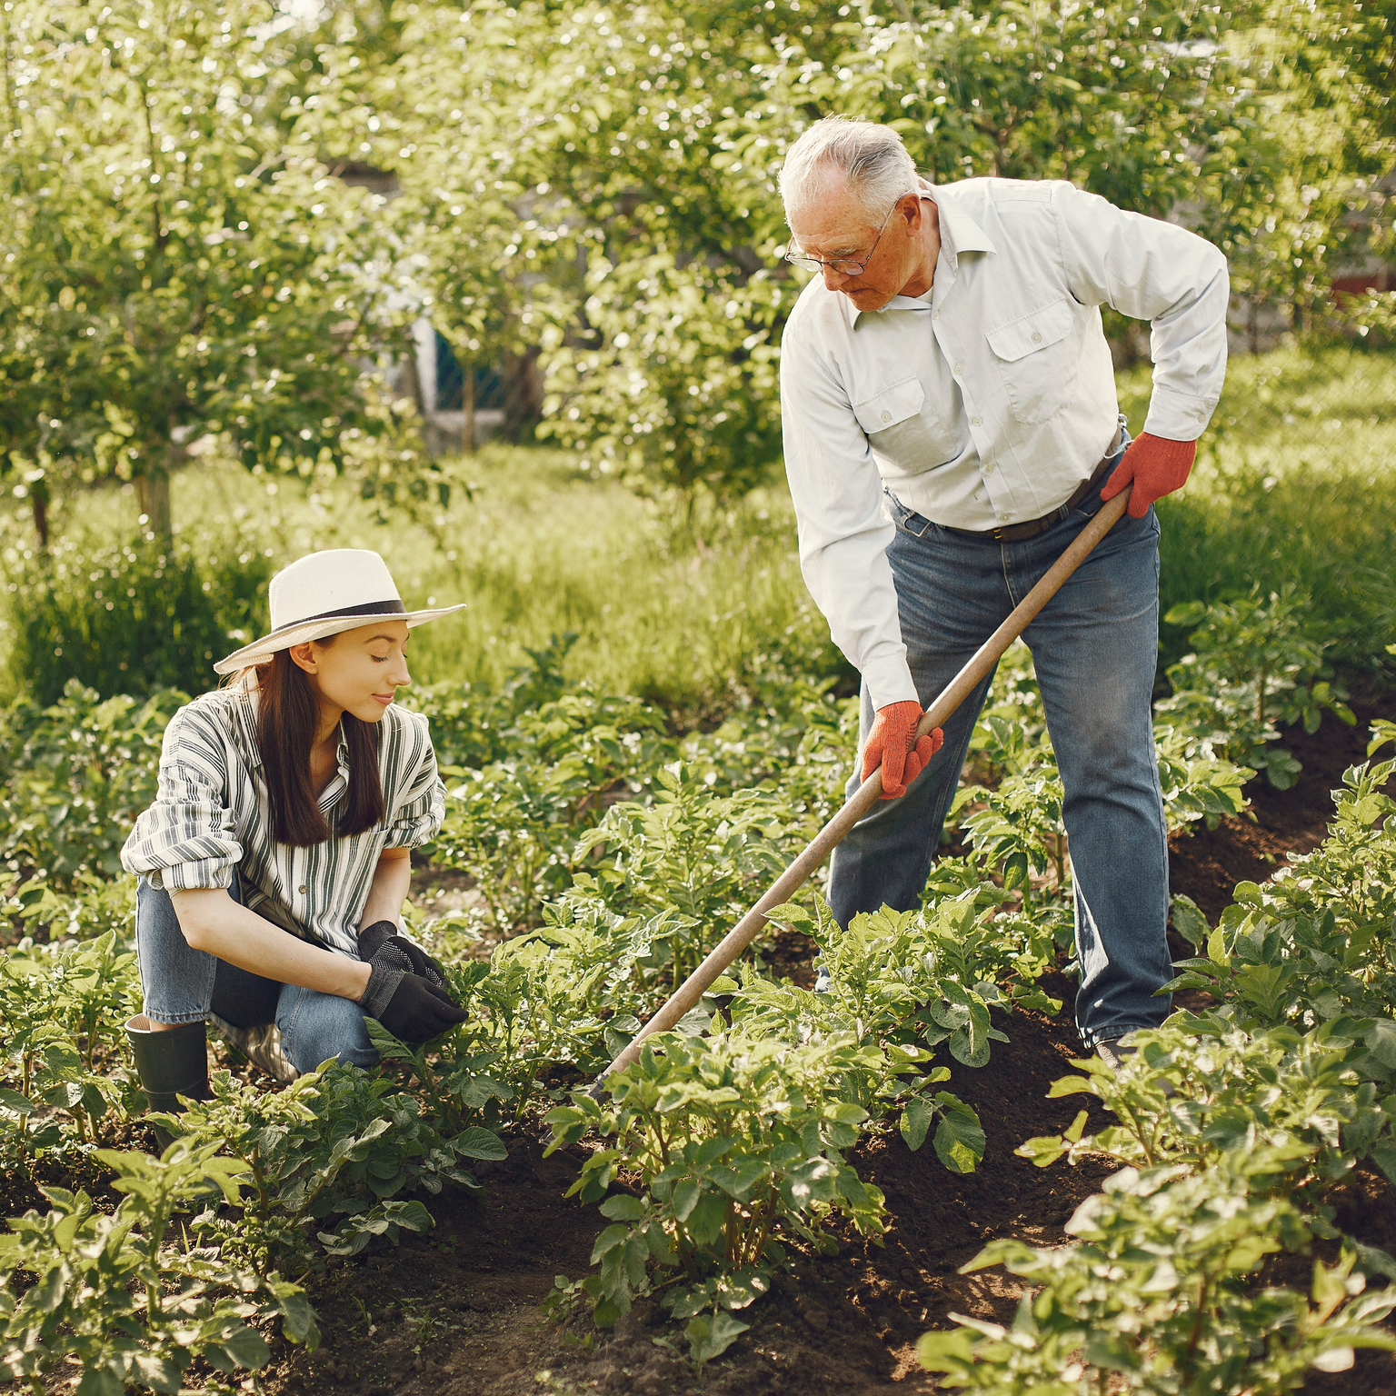
Ginyard International Co.
Home
Service
About Us
Contact
Welcome To Our Project
Plant diseases are a major concern in agriculture, affecting crop yield and food security. Early detection of these diseases is crucial for effective disease management. In this project, we developed a deep learning model using Convolutional Neural Networks (CNN) to detect plant leaf diseases based on images of the leaves.

Slide 3
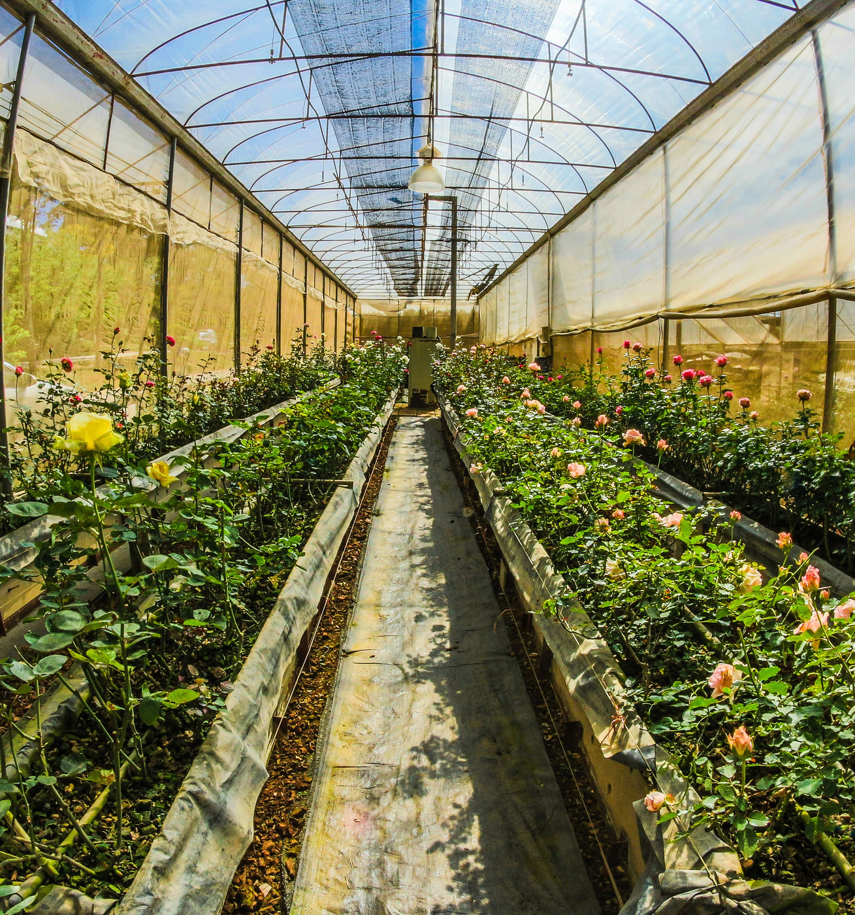
Home
Service
About Us
Contact
Dataset Overview
01
Healthy
These are pictures of plants that are doing well without any sickness or bugs bothering them.
02
Powdery
This category shows plants that have a kind of white or grayish powdery stuff on them, usually caused by a fungal infection called powdery mildew.
03
Rust
These pictures are of plants with reddish-brown or orange spots on their leaves or stems, which is often a sign of another fungal disease known as rust.
Overall, the dataset provides a diverse range of images representing different types and severity levels of plant diseases, as well as healthy plant samples. This diversity allows for robust training of machine learning models for plant disease classification and detection

Slide 4
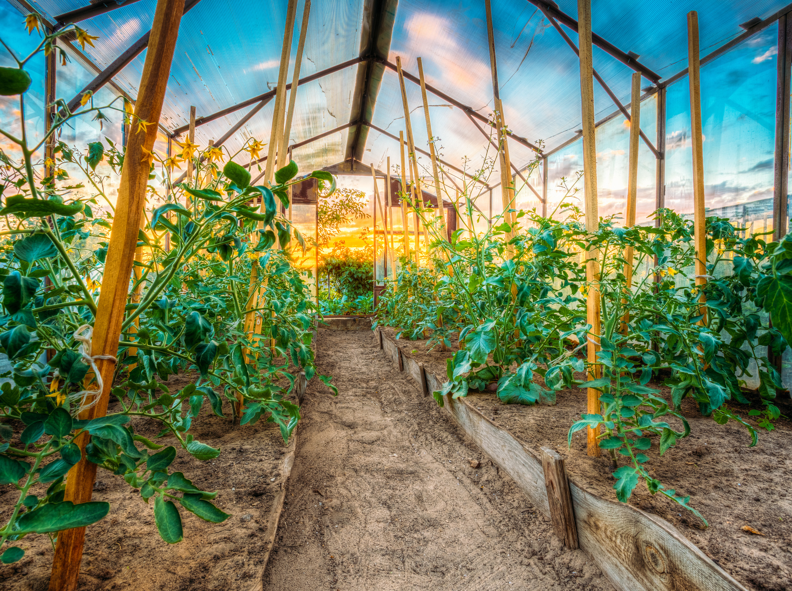
Ginyard International Co.
Home
Service
About Us
Contact
Background
This section provides an overview of existing research on plant disease detection methods. It contrasts traditional approaches, relying on visual inspection and manual diagnosis, with modern techniques such as deep learning, particularly Convolutional Neural Networks (CNNs), which automate the detection process. The slide discusses the advantages of deep learning methods over traditional ones and acknowledges challenges such as limited data availability and variability in image quality.

Slide 5
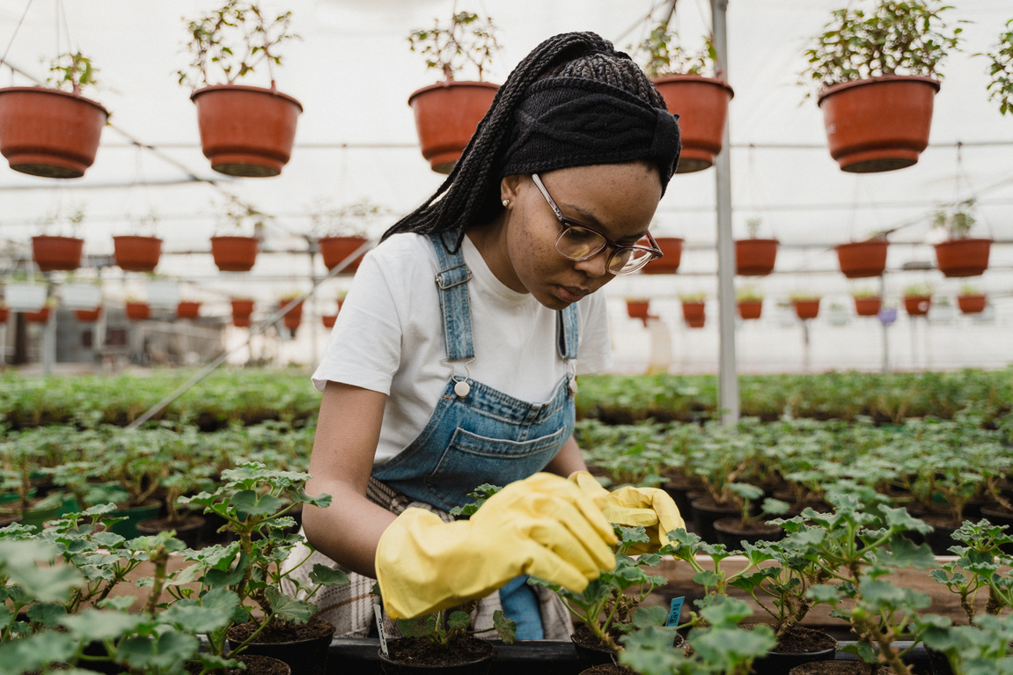
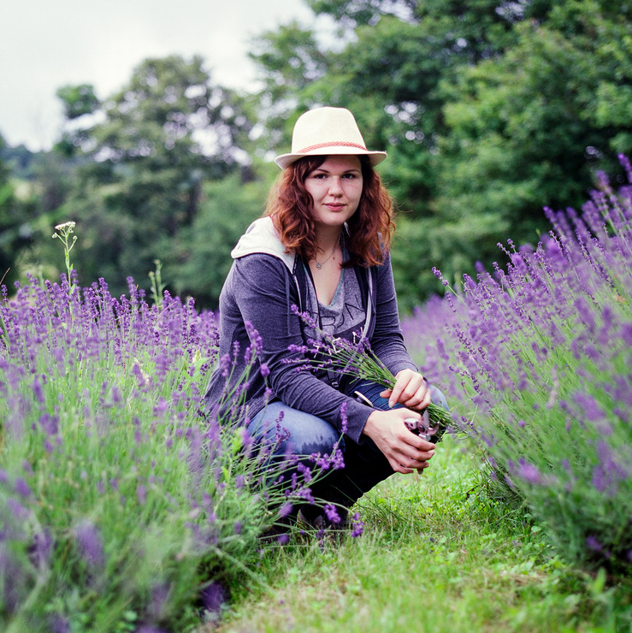
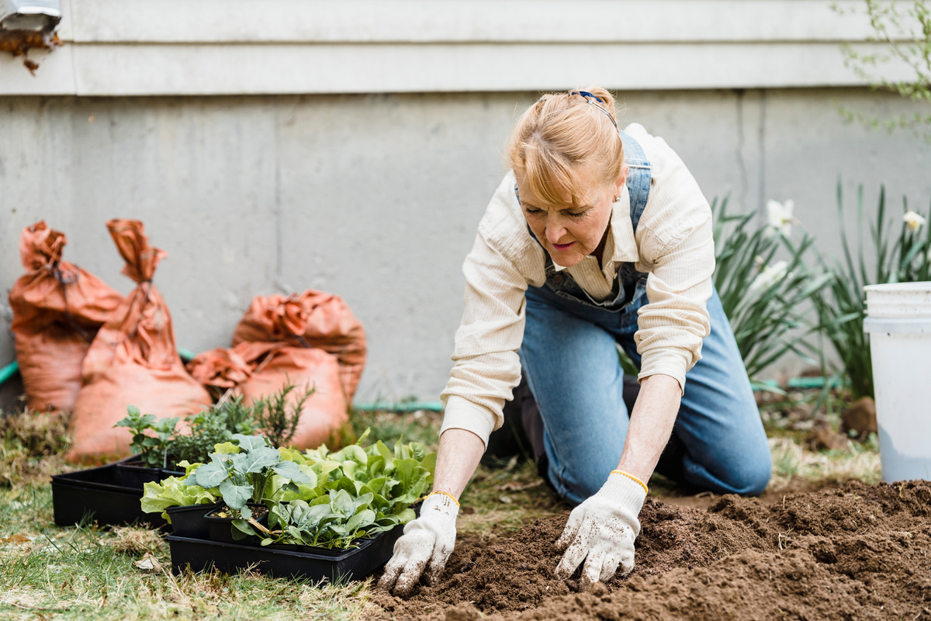
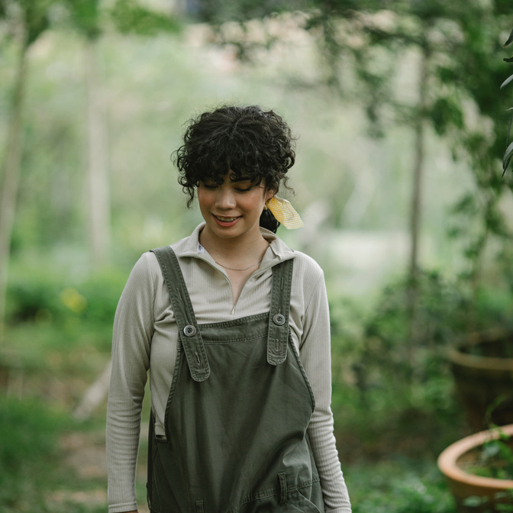
Ginyard International Co.
Home
Service
About Us
Contact
Methodology
Data Collection and Data Preprocessing
Model Development and User Interface Design:
Integration & Testing
Deployment
Integrating the model with the user interface and conducting rigorous testing to ensure accuracy and reliability.
Deploying the system for practical use in agriculture, with considerations for scalability and usability.
Gathering a diverse dataset of plant leaf images, including healthy and diseased samples.n.
Designing and training a CNN architecture for disease classification, utilizing transfer learning for enhanced performance.

Slide 6

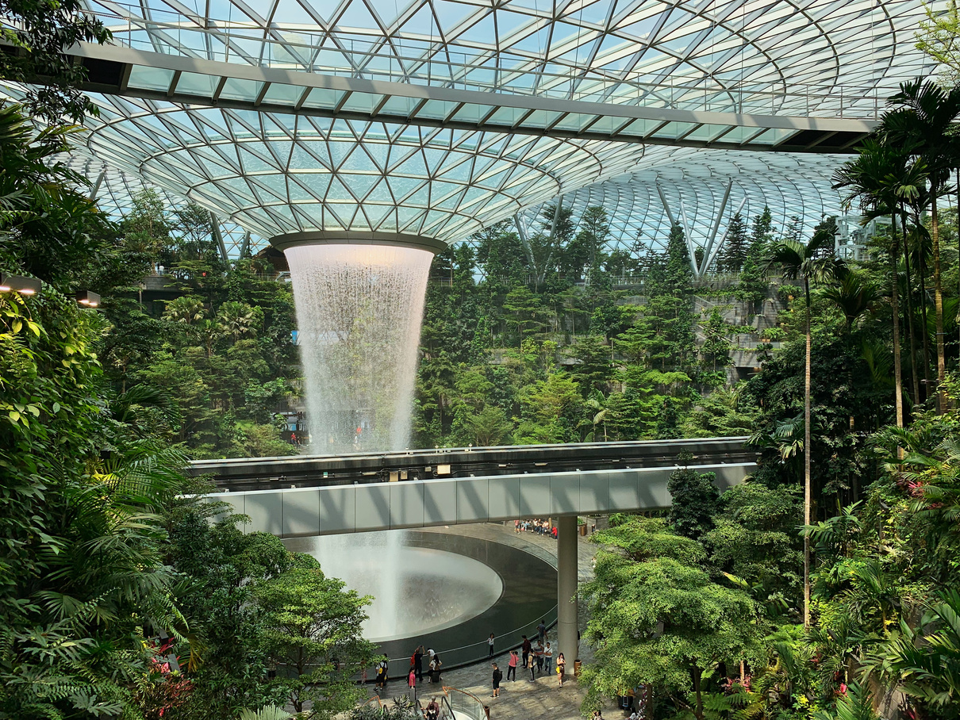
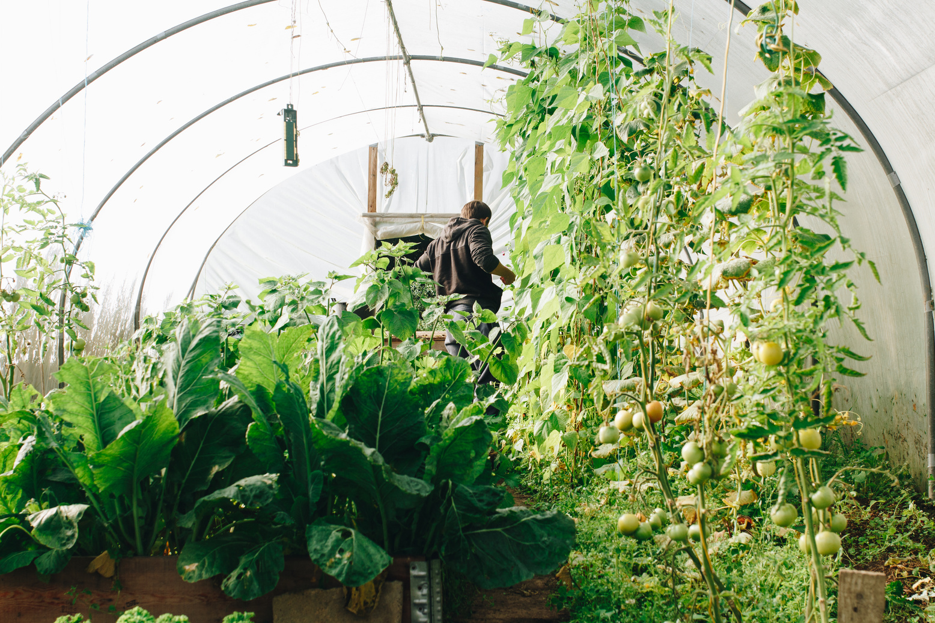
Ginyard International Co.
Home
Service
About Us
Contact
Test Cases/Test Results Summary
Summarizes test case outcomes, including accuracy metrics, user interface functionality, and system integration.
Discussion on Achievements
Findings and Rectifications Suggested/Applied
Highlights successful implementation of the CNN model, user interface development, and system integration.
Discusses challenges encountered during the project and the solutions implemented to address them.

Slide 7
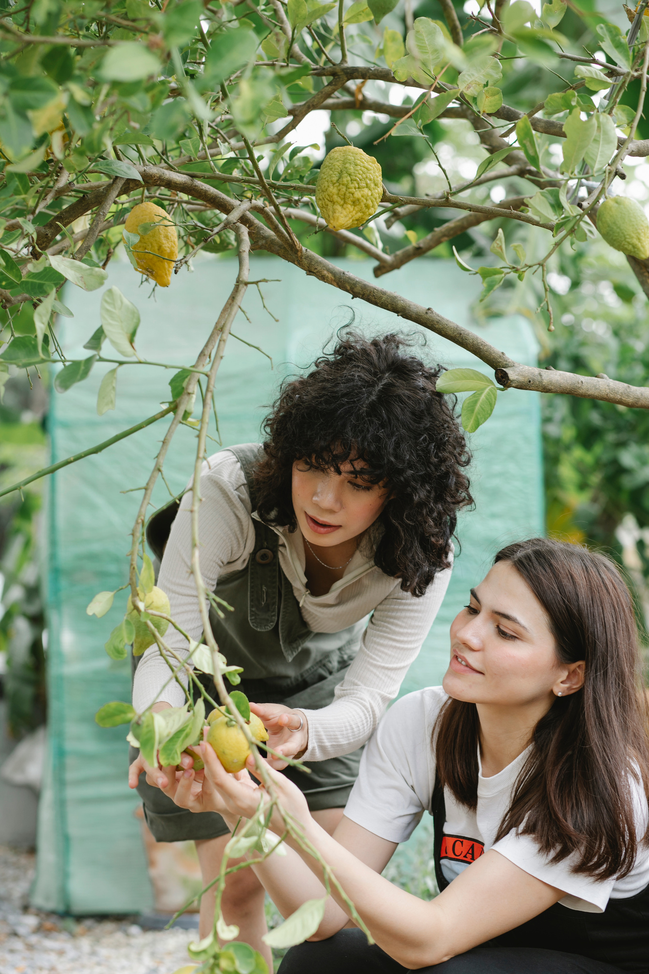
Ginyard International Co.
Home
Service
About Us
Contact
Model Building
01
Introduction
02
Objectives
In our project, we constructed a convolutional neural network (CNN) model using TensorFlow and Keras to effectively classify plant diseases based on input images.
Our primary aim was to design a CNN architecture capable of discerning critical features from the input images, facilitating accurate disease classification. Additionally, we sought to fine-tune the model's hyperparameters to enhance its performance.
03
Methodology
04
Results
To achieve our objectives, we meticulously designed the CNN architecture, incorporating essential components such as convolutional and pooling layers. These layers played a pivotal role in extracting meaningful features from the input images and subsequently classifying them into distinct disease categories.
Through rigorous experimentation and optimization, we successfully developed a CNN model that exhibited commendable accuracy in the classification of plant diseases. Our model demonstrated robust performance across various datasets, highlighting its effectiveness in real-world scenarios.

Slide 8
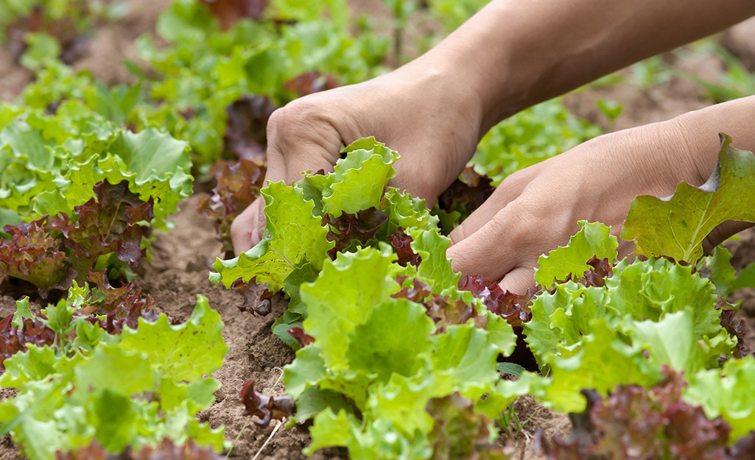
Ginyard International Co.
Home
Service
About Us
Contact
Model Training
01
Introduction
02
Objectives
Our team undertook the crucial task of model training using TensorFlow and Keras to construct a convolutional neural network (CNN) tailored for plant disease detection.
Our primary objectives included preprocessing the dataset, splitting it into training and validation subsets, and selecting optimal CNN architectures and hyperparameters.
03
Methodology
04
Results
We commenced by preprocessing the dataset, applying techniques such as data augmentation and normalization to enhance model robustness. Subsequently, we explored various CNN architectures and hyperparameters through iterative experimentation. This process involved training the models using TensorFlow and Keras, fine-tuning parameters, and evaluating performance metrics.
Our efforts culminated in the successful training of a CNN model adept at accurately identifying plant diseases. Through meticulous experimentation and optimization, we achieved impressive precision and accuracy levels.

Slide 9
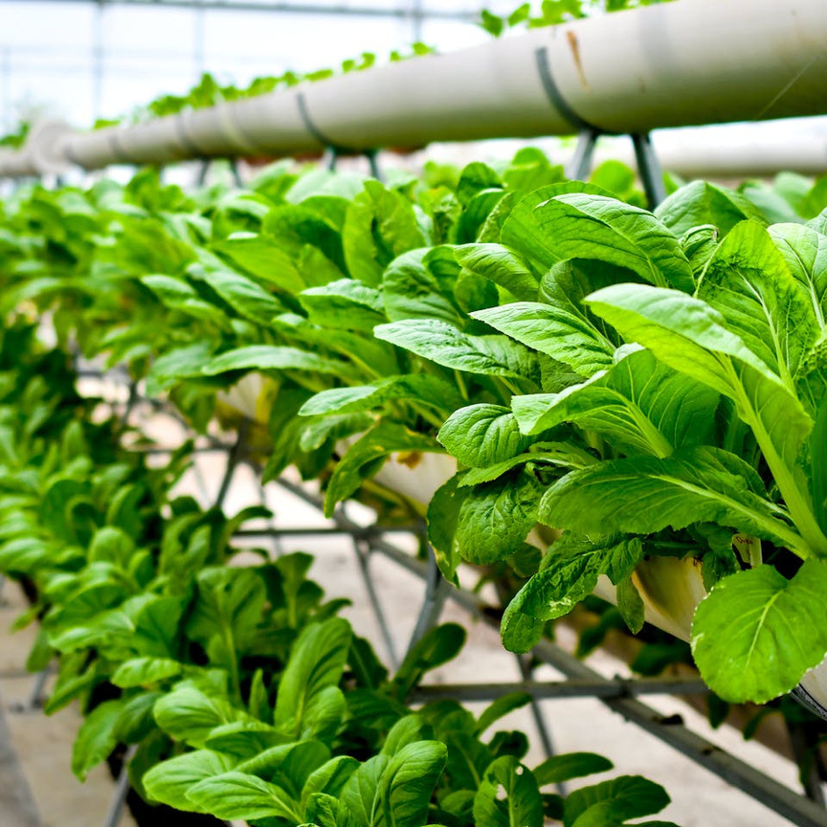
Ginyard International Co.
Home
Service
About Us
Contact
Flask web application
01
Introduction
02
Objectives
Our team developed a Flask web application to serve as the user interface for our plant disease detection system. This web application allows users to interact with the system easily through their web browsers.
The main objectives of this contribution were to implement the necessary routes, views, and templates using the Flask framework
03
Methodology
04
Results
To achieve these objectives, we utilized the Flask framework, a lightweight and flexible web application framework in Python.
As a result of our efforts, we successfully developed a responsive and intuitive web application. Users can easily navigate through the different pages of the application, upload images for disease classification, and view the results.

Slide 10
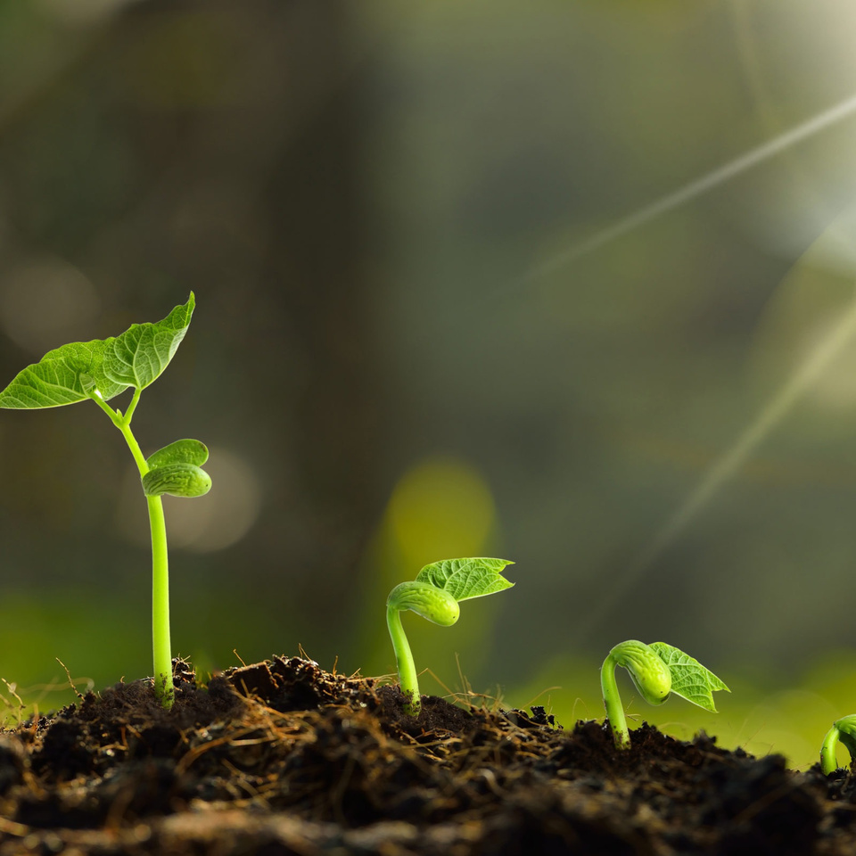
Ginyard International Co.
Home
Service
About Us
Contact
Import.html
01
Introduction
02
Objectives
Our team developed the import.html file as part of the user interface design for the plant disease detection system.
Design a user-friendly layout for uploading images to the system.
Ensure compatibility and responsiveness across different devices and browsers.
03
Methodology
04
Results
Designed the layout and structure of the import.html file using HTML.
Incorporated file input fields and buttons to facilitate image uploads.
Successfully created an intuitive interface for users to upload images for disease classification.

Slide 11
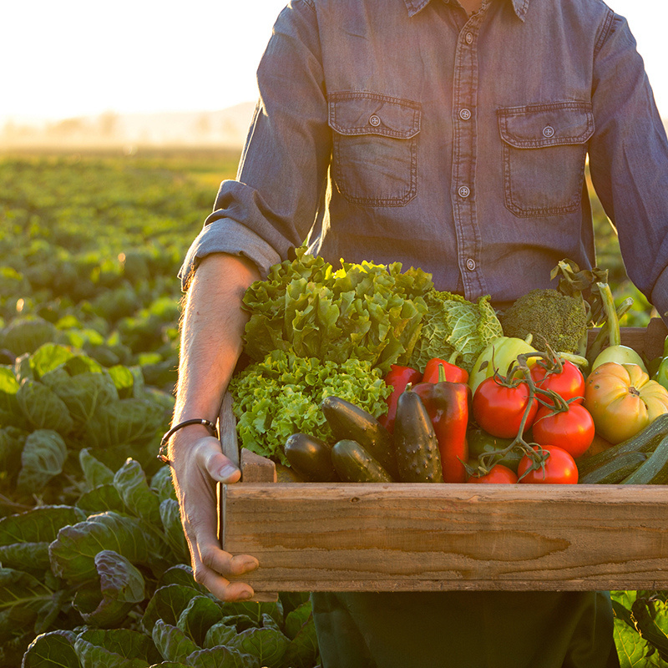
Ginyard International Co.
Home
Service
About Us
Contact
Index.html
01
Introduction
02
Objectives
The index.html file serves as the main interface through which users interact with our plant disease classification system. It provides a user-friendly environment for uploading images and obtaining predictions regarding the presence of plant diseases.
Our primary objective in designing the index.html file was to create an intuitive and efficient interface that empowers users to upload images seamlessly and receive accurate disease classification predictions. Additionally, we aimed to enhance user engagement and satisfaction by ensuring clarity and simplicity in the interface design.
03
Methodology
04
Results
To achieve our objectives, we utilized HTML and integrated dynamic elements to facilitate image upload and prediction functionalities. The layout was carefully structured to optimize user experience, with clear instructions and prominent action buttons guiding users through the process.
The index.html file successfully fulfills its intended purpose, providing users with a straightforward and user-friendly platform for uploading images and obtaining disease classification predictions. The integration of dynamic elements and clear instructions enhances usability, enabling users to interact with the system effortlessly.

Slide 12
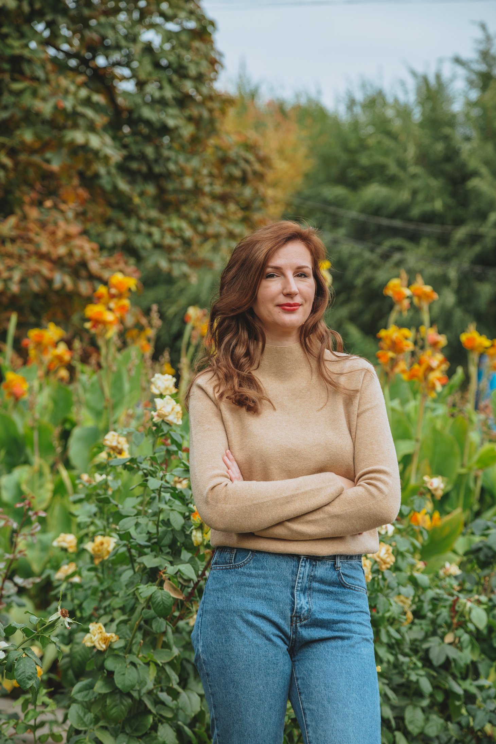
Ginyard International Co.
Home
Service
About Us
Contact
Thank You !
Our project on "Plant Disease Classification Using Deep Learning" has successfully developed a robust Convolutional Neural Network (CNN) model and a user-friendly interface for real-time disease diagnosis in agriculture. Through innovative solutions and collaborative efforts, we have addressed challenges and demonstrated the potential of technology to revolutionize disease management. Future endeavors will focus on optimization and expansion to further enhance the system's effectiveness in agricultural practices.

